Slide 1
Combustor design
Circulating Fluidized Bed Boiler
Dowon SHUN
Korea Institute of Energy Research
Notes:
산업용 보일러의 운전특성을 요약하였다.

Slide 2
Non Pressure Parts

Slide 3
Terminal points
Drum
To Steam
Generator
Cyclone
S/H2
Hopper
S/H1
SDR
Scrubber
Combustor
Eco
Water
A/H
Ash cooler
Air
ID Fan
FD Fan
Stack

Slide 4
5
8
9
7
10
4
11
1
3
12
2
6
Pressure Part
3. EVA, 5 Drum, 9 S/H2, 10 S/H1, 11 ECO
Non pressure part
1 Feeder, 2 Air box, 4 Combustor, 6 Duct burner, 7 Cyclone, 8Convection pass, 12 Air heater

Slide 5
Design specifications
Item | Unit | Value
Number of unit | - | 1
Type | - | One drum natural circulating fluidized bed coal combustion boiler with Dual cyclone and Single convection pass
Location | - | In door
Steam quality | - | Max/(Nominal)
Evaporation | ton/h | 105/(96)
Pressure at final super heater exit | bara | 67/(65)
Steam temperature | ℃ | 487/(487)
Power generation | MWe | 22
Average solid contents in final steam | ppm | 1.0
Average solid contents in drum | ppm | 750
Feed water at Ash cooler inlet | ℃ | 196/(192)
Steam temperature control range | ℃ | 477-487
Draft system |  | Balanced draft
Turn down ratio |  | 2 : 1
Ambient temperature | ℃ | 20
Reference relative humidity | % | 60

Slide 6
Emission targets
대기환경보전법 시행규칙 별표8 (2013)
고형연료 2000kg/h이상 전용시설
Parameter | Unit | Value
Sox | mg/Nm3(%O2) | 30(12)
Nox | mg/Nm3(%O2) | 70(12)
CO | mg/Nm3(%O2) | 50(12)
Particulates | mg/Nm3(%O2) | 20(12)
HCl | ppm(%O2) | 12
dioxine | TEQ | 0.1

Slide 7
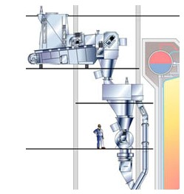


Fluff 전용 RDF 연소 보일러 공정도
Feeding
Boiler island
SDR
Bag filter
Stack
건식 SDR로 소석회와 활성탄을 반응기에 뿌린후 bag filter에서 집진하는 방식

Slide 8
1MWe RDF combustion CFB Co-generation boiler system
Notes:
1MWe RDF 연소 CFB 열병합 보일러의 공정도이다. 보일러 설비는 연소로와 대류전열부로 구성되며 후처리 설비는 Semi Dry Absorption Reacto, 백필터, 세정탑(scrubber), 연돌(Stack)으로 구성된다.

Slide 9
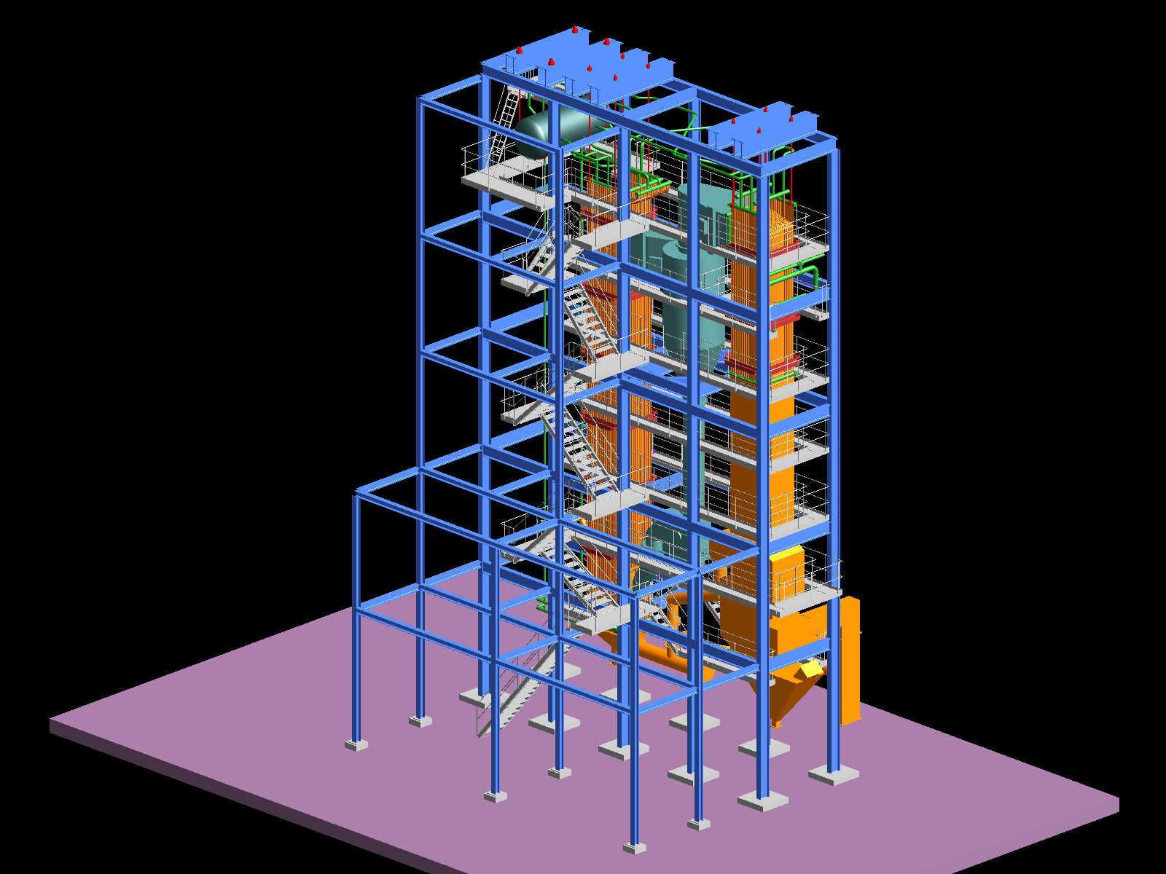
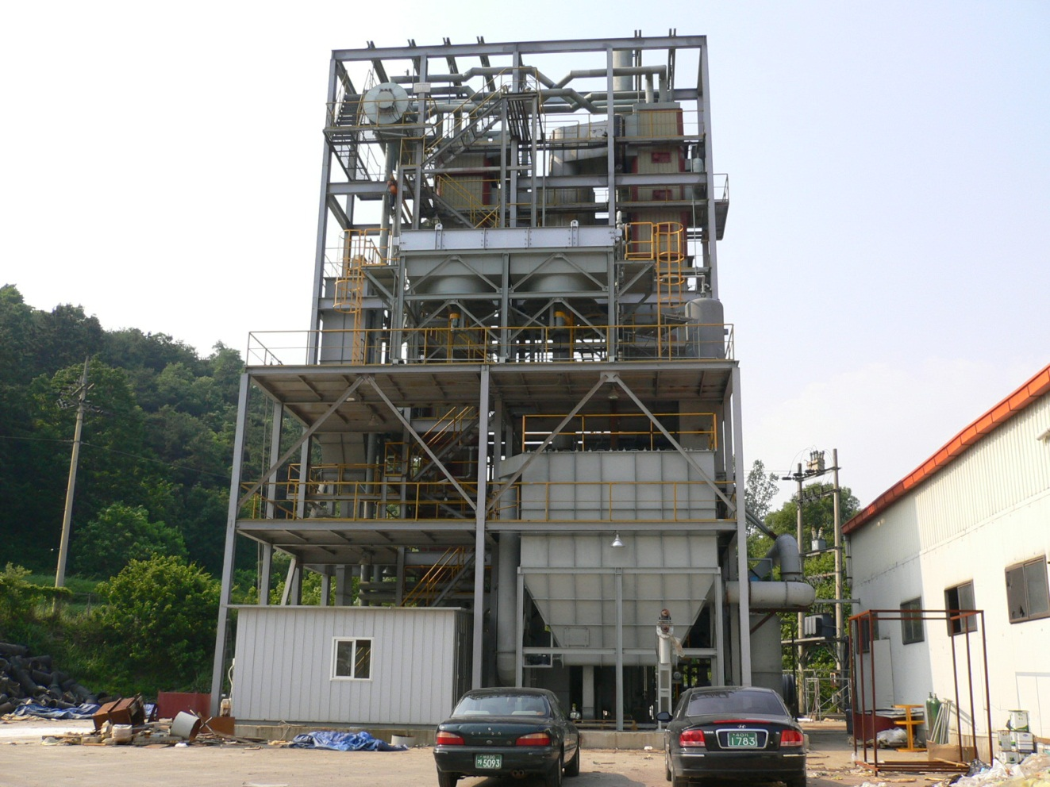
Kier 1MWe co-generation CFB boiler
The 8MWth and 1MWe capacity boiler designed by KIER and Korean material
Notes:
8MWth, 1MWe 순환유동층 보일러의 조감도와 사진을 나타내었다. 모든 재료는 국산이며 국내 기술만으로 설계 제작 건설되었다.

Slide 10
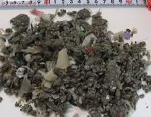
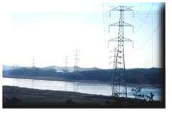
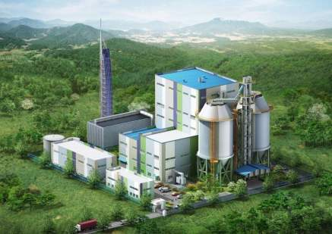
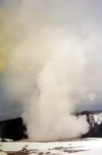
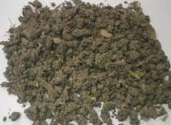
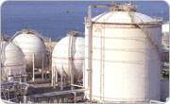
Wonju Green Power
10MWe RDF Co-genertion
KIER Technology
Basic Design
Clinker Control – Additives use
Control Temperature - Ash Recirculation
State of the Art design - 2nd evaporator

Slide 11
Wonju 10MWe CFBC for RDF
Notes:
11

Slide 12
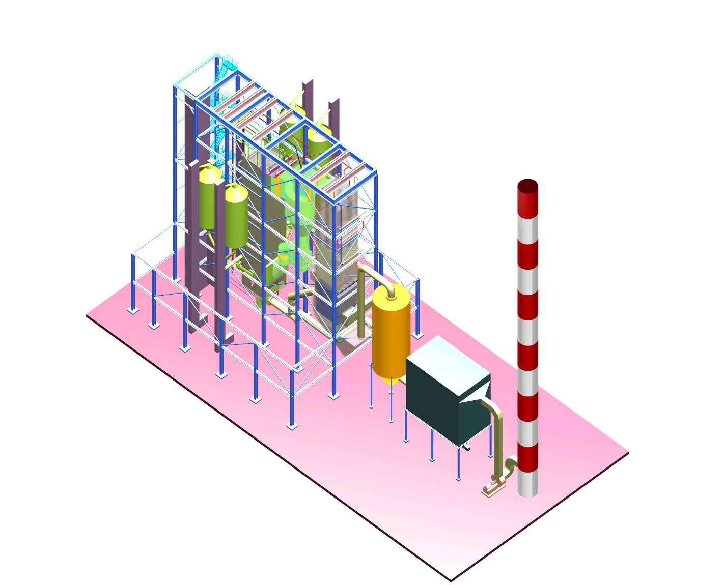
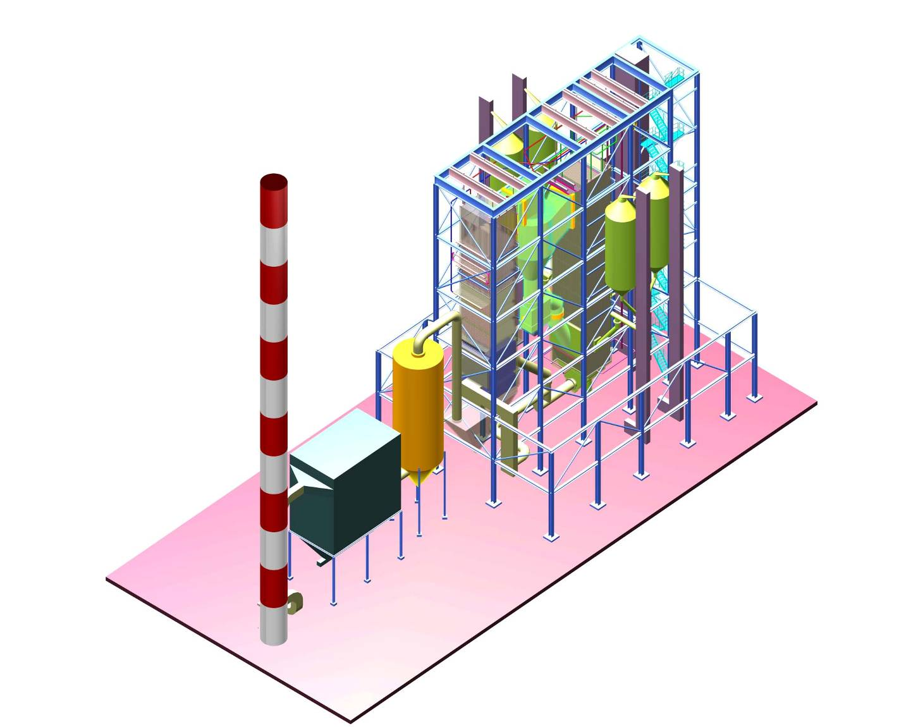
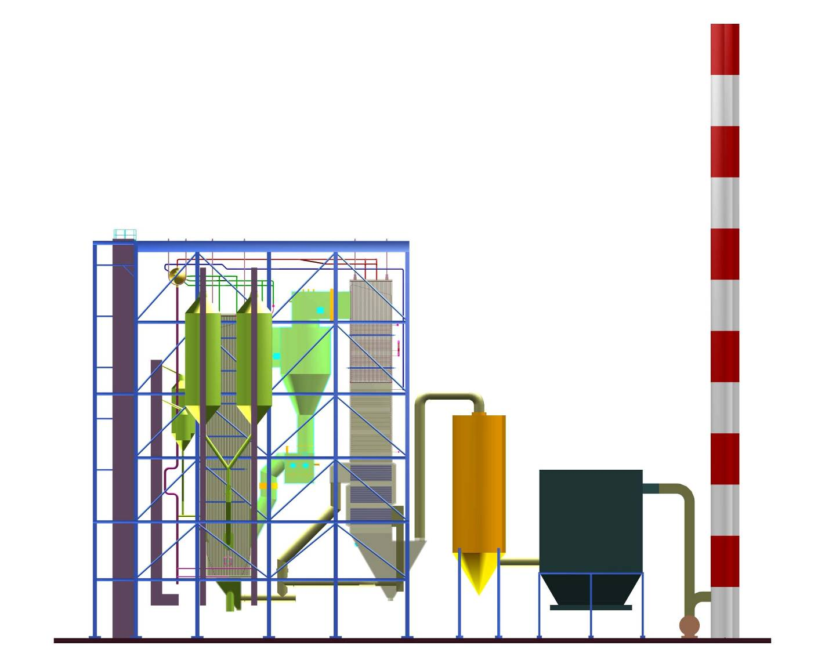
원주 10MWe 발전용 보일러 조감도

Slide 13
New 10MWe Circulating fluidized bed boiler
Drum
S/H2
To Steam
Generator
S/H1
Cyclone
Econ.
A/C
Fuel
Econ.
Econ.
Additive
Combustor
SCR
A/H
SDR
A/H
Feed Water
A/H
Air
FD Fan
Stack
ID Fan
Notes:
13

Slide 14


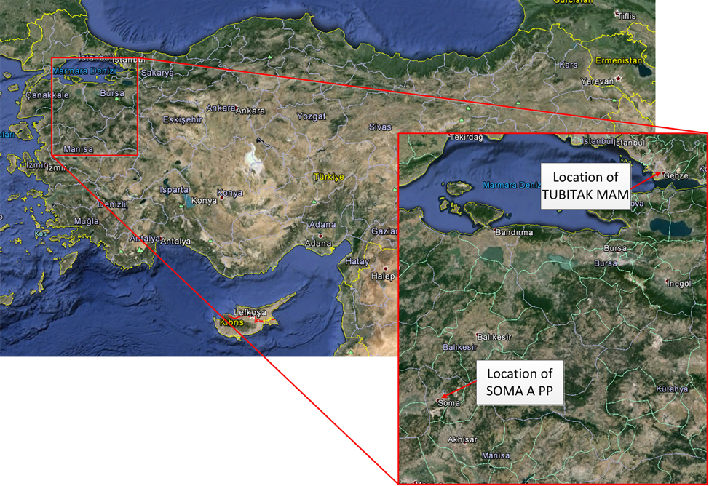
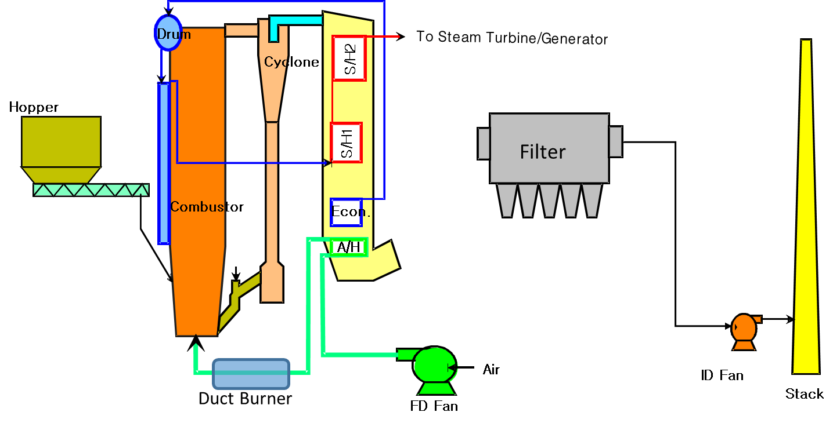
22MWe CFBC for Turkish Lignite
SOMA, TURKEY 2014-2015
SOMA 22MWe Power Plant Repowering
KIER CFBC Design
Basic Design Contract
CFBC for lignite combustion power plant
SOMA Site
Notes:
소개한 기술의 기술이전이나 국제협력 사례가 있을 경우, 동 페이지 작성
국제협력사례 : 완료사업이 아니더라도, 협력 논의 중이지만, 발표 공개할 수 있는 경우 작성
(예시) 기술이전 논의, 국제공동연구, 워크샵, 인력교류, 상호 기관방문, 컨설팅

Slide 15
Soma 22MWe CFBC Boiler
Drum
To Steam
Generator
Cyclone
S/H2
Hopper
S/H1
Combustor
Eco
Water
A/H
Ash cooler
Air
ID Fan
Stack
FD Fan

Slide 16
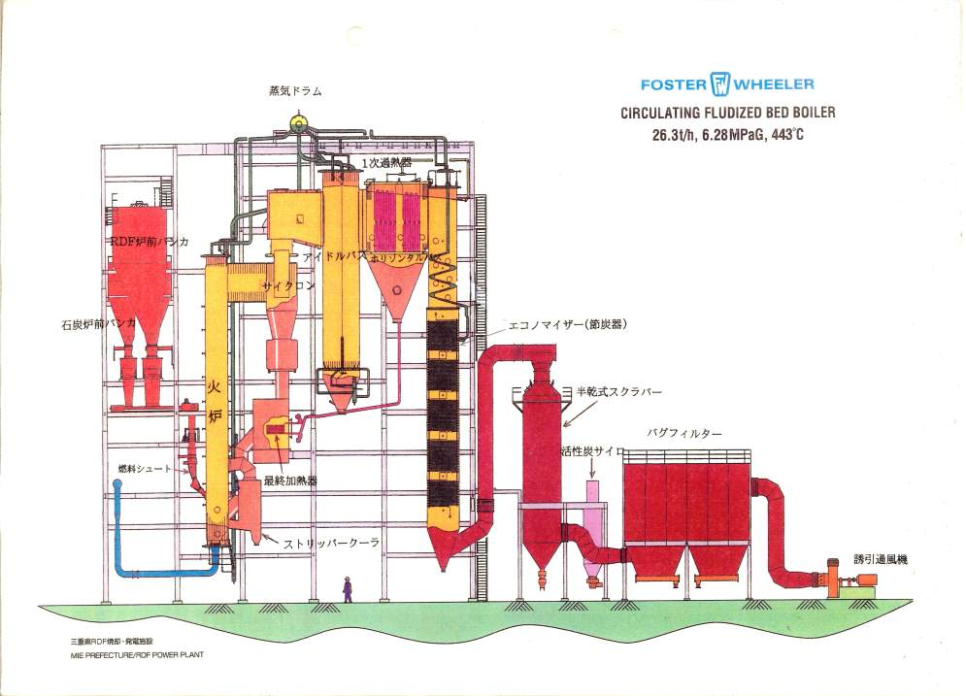
三重ごみ固形燃料発電所の焼却施設

Slide 17
CFB Co-Gen. Boiler for Fluff Fuel
Post combustion
Cyclone
Air heater
Low gas velocity
Empty pass
Convection pass
Combustor
ITEM | VALUE
Capacity | 35~75ton/h (5~15MWe)
Steam quality | 425℃ 45~60bara
USE | Waste to Energy
EHE

Slide 18
CFB Steam Boiler for Sludge/Plastics fuel
Cyclone
Air
heater
Empty pass
ECO
Combustor
ITEM | VALUE
Capacity | 10~30ton/h (5~15MWe)
Steam quality | 200℃ 45~60bara
USE | Steam for Industry
Dryer
EHE

Slide 19
BFB Steam Boiler for Biomass
Drum
ECO
2nd W/W
Empty pass
Combustor
ITEM | VALUE
Capacity | 10~20ton/h (5~15MWe)
Steam quality | 200~300℃ 10~15bara
USE | Steam for Industry

Slide 20
Design criteria of combustor
Simple → low cost, easy maintenance(unit module)
Easy operation → No hot spot, stable air distribution
Efficiency → Minimize dynamic resistance, high yield of steam
Environmental factor → low emission, no leak
Durability → Thermal corrosion, erosion, Clinker deposit, Chloride attack

Slide 21
Simple vs. Better Control

Slide 22
Design Considerations I
Parts | Consideration | Design criteria
Storage silo | One for each fuel | 1week supply
Surge bin | Stable continuous feeding | 4hr + supply
Feeder | System for individual fuel characteristics Dual feeding system for mechanical malfunction | Physical properties of fuel
Combustor | Locate ash return and fuel feeding height over static bed | ▪ Static bed : 600 mm ±100 ▪ Gas velocity : 4~6 m/s ▪ Excess air : 1.2~1.5 ▪ Water-wall
Cyclone | Ash circulation is more important to maintain bed density than collection efficiency | collect bed material 0ver 0.1mm
Loop seal | Discharge pressure over 1.5 x FD fan | ▪ Roots Blower : > 3000 mmAq ▪ Bed air velocity: 0.5~1 m/s
EHE | dp > 0.1mm bubbling bed | ▪ gas velocity : 1 ~ 2m/s
VIII-12

Slide 23
Design Considerations II
Parts | Consideration | Design criteria
Bottom ash drain | Easy withdraw of coarse and non combustable | Bottom Ash removal + Ash Cooling
Convection Pass | Gas velocity | Gas velocity through tube passage < 10m/s
Air heater | Requires wide surface area due to low heat transfer coefficient | If possible heat only P/A
Fans | Inverter control for ID fan Damper control for FD and SA Loop seal fan damper and valve control | PA Fan ~ 2000mmH2O SA Fan: ~1000mmH2O ID fan ~850mmH2O
Start-up/ Ignition Burner | Duct burner supports automatic heat up Lance burner unstable in CFBC To Use Duct burner cool down nozzle by locating evaporator tube at distributor plate | ▪ > 500 ℃ heat up ▪ Use separate ignition burner to catch fire
VIII-12

Slide 24
Lay out of Combustor and Back pass
Superheater
Combustor
Cyclones
Economizer
Air heater
B1
A1
B2
A2

Slide 25
Combustor
Combustor sizing
Evaporator lay out(Water wall, Wing wall)
2nd Super heater, Re-heater lay out
Air feeding(distributor, 2nd air, feeding air hole)
Solid handling hole(Fuel feeder, limestone feeder, sand feeder, Ash cooler and disposal)

Slide 26
Combustor height
Burnout time of fine char particles of 50microns
>> Burnout time of combustible gases
Reaction time for sulfur retention
Heat transfer surface requirement
(Membrane wall, Wing wall, Super heater, Reheater)
Standpipe height to secure ΔP against solid reverse follow from combustor to loop seal

Slide 27
연료의 반응성 차이에 따른 연소성
Bituminous coal
Anthracite
TGA study of the reactivity of coals

Slide 28
Combustor cross sectional area
V = 5m/s at free board
850 < T < 900℃
Q = 3MW/m² at the bed surface
2nd air penetration distance
Fuel and limestone feeding distance
(Depth < 7.5m)
Recycled particles circulation ~ 1m above distributor plate
Width/depth ratio of 1 ~ 2

Slide 29
Heat transfer unit of 10MWe CFBC boiler for RDF
Combustor
-Water wall – 4m x 4m x 24m - 30MWth
- Drum
Hot cyclone - ID 4m x 9m
Convection pass
Superheater 2 – 5MWth
Superheater 1 – 5MWth
Economizer – 8MWth
Air heater – 2MWth

Slide 30
Boiler capacity vs. Cross sectional area
Engineering Data

Slide 31
FW feeding system 2014
Engineering Data
Grid Area |  | Low Volatile Fuel | High Volatile Fuel |  | Area/feeder
m2 | ft2 |  | Min | MAX | m2/#
9 | 100 | 1 | 1 | 2 | 9
18 | 200 | 2 | 2 |  | 9
27 | 300 | 2 | 2 | 4 | 14
37 | 400 | 4 | 4 | 6 | 9
55 | 600 | 6 | 6 | 8 | 9
74 | 800 | 6 | 8 |  | 12
93 | 1000 | 6 | 8 | 10 | 16
112 | 1200 | 8 | 10 | 12 | 14
131 | 1400 | 8 | 10 | 12 | 16
150 | 1600 | 10 | 12 | 14 | 15

Slide 32
Suppression of Ceiling wall erosion
4m
15deg
1m
Combustor ceiling
>2m
Buffer zone
Gas exit
To cyclone

Slide 33
Comb shaped plate
3.5 ~ 5mm tk
50mm
Combustor ceiling
Errosion zone
Gas exit
To cyclone

Slide 34
Cyclone 설계

Slide 35
Multi inlet cyclone
Bed 유속 high
Free board 유속 low
CYMIC 40TPH Compact ICFBC

Slide 36
Multi outlet cyclone
전체 유속 일정
벽면 입자 하강흐름 동승

Slide 37
Multi outlet cyclone

Slide 38
Double cyclone
Compact design high efficiency
외부 사이클론 효과는 낮음
내부 사이클론 입구 마모를 막기위해 외부 사이클론 입구 흐름 라인 조절

Slide 39
Integrated combustor -cyclone
기존 석유화학 공정의 내부 사이클론과 동일
Foster Wheeler 등에서 Compact cyclone 기술로 적용

Slide 40
Hot Cyclone for CFBC
In hot condition of 800~900℃
In high ash concentration in flue gas of 10,000~30,000mg/Nm3
negative pressure at cyclone inlet and outlet
High d50 required for low ash fuel and for high particle suspension density
Heat transfer coefficient

Slide 41
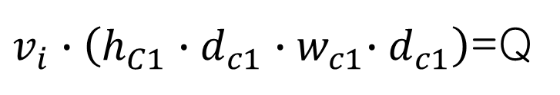
Cyclone
ew
dc2
eh
hc1
$v_{i}∙\left(h_{C1}{∙d_{c1}∙w}_{c1}∙d_{c1}\right)$=Q
hc5
hw
wc1
hc2
dc1
hc4
hc1/dc1 = 0.5 ~ 0.75
wc1/dc1 = 0.2 ~ 0.375
hc5/dc1 = 0. 5 ~ 0.875
dc3/dc1 = 0.2 ~ 0.375
hc2/dc1 = 1.5 ~ 2
hc3/dc1 = 1.5 ~ 2
dc1-dc2 > 2*wc1
ww
hc3
dc3

Slide 42
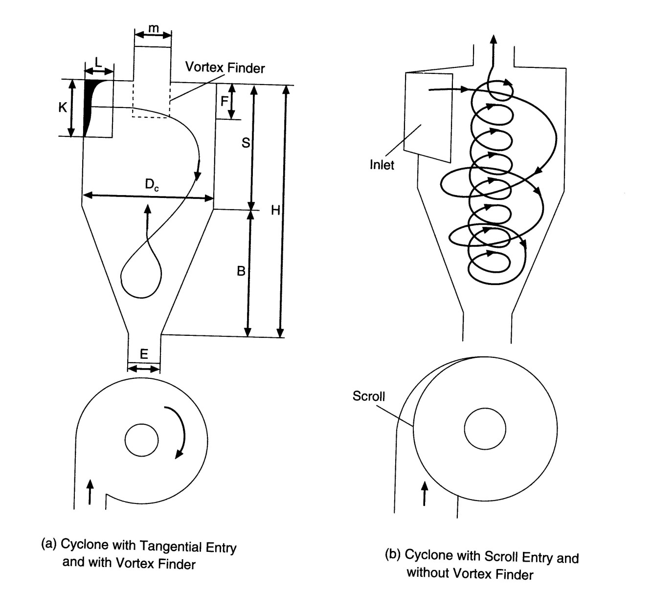
Cyclone
Vr
Vi
Vi
Vt
Notes:
구심력 관점으로 보면 Vr이 안쪽

Slide 43
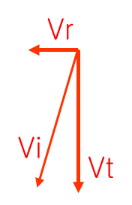
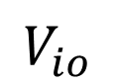
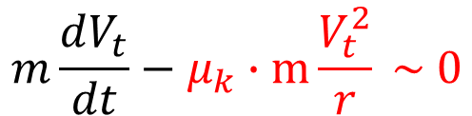
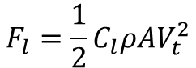
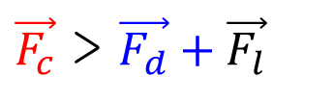
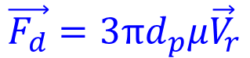
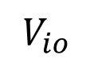
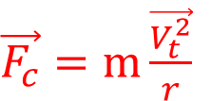

dc2
wc1
Centrifugal force
$\vec{F_{c}}=m\frac{\vec{V_{t}^{2}}}{r}$
hw
$$V_{io}$$
Lift
$$F_{l}=\frac{1}{2}C_{l}ρ{AV}_{t}^{2}$$
ww
dc1
Drag force
$$mg$$
$$\vec{F_{d}}=3πd_{p}μ{\vec{V}}_{r}$$
$\vec{F_{c}}$ > $\vec{F_{d}}+\vec{F_{l}}$
dc3
Particle velocity
Friction force
$$m\frac{dV_{t}}{dt}−μ_{k}∙m\frac{V_{t}^{2}}{r} \sim 0$$
$$V_{io}$$
Notes:
구심력 관점으로 보면 Vr이 안쪽

Slide 44
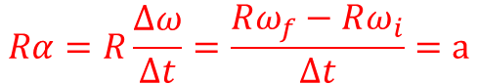
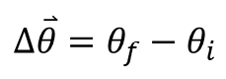
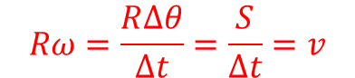
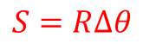
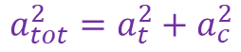
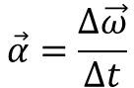
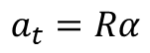
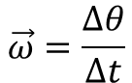
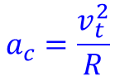
Angular motion
Tangential
Accleraion
Centripetal acceleration
Angular velocity[radians/sec]
$$a_{c}=\frac{v_{t}^{2}}{R}$$
$$a_{t}=Rα$$
$$\vec{ω}=\frac{∆θ}{∆t}$$
Changes the direction of the velocity
Total accleration
$$a_{tot}^{2}=a_{t}^{2}+a_{c}^{2}$$
Angular displacement [radians]
Arc length [m]
$$∆\overset{⃑}{θ}=θ_{f}−θ_{i}$$
+
$$S=R∆θ$$
$$Rω=\frac{R∆θ}{∆t}=\frac{S}{∆t}=v$$
R
Angular acceleration rad/s^2]
$$Rα=R\frac{∆ω}{∆t}=\frac{Rω_{f}−Rω_{i}}{∆t}=a$$
$$\vec{α}=\frac{∆\vec{ω}}{∆t}$$
Changing speed only, its not a vector
Notes:
Changing speed only its not a vactor

Slide 45

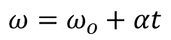
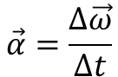
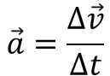
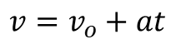
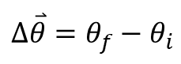
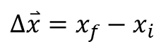
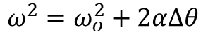
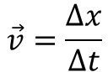
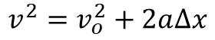
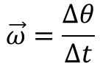

Linear vs Rotational
Linear
Rotational
$$∆\overset{⃑}{x}=x_{f}−x_{i}$$
$$∆\overset{⃑}{θ}=θ_{f}−θ_{i}$$
$$∆x={\left(\frac{v+v_{o}}{2}\right)t=v}_{o}t+\frac{1}{2}at^{2}$$
$$∆θ={\left(\frac{ω+ω_{o}}{2}\right)t=ω}_{o}t+\frac{1}{2}at^{2}$$
$$\vec{v}=\frac{∆x}{∆t}$$
$$\vec{ω}=\frac{∆θ}{∆t}$$
$$v=v_{o}+at$$
Only if a is constant
Only if α is constant
$$ω=ω_{o}+αt$$
$$v^{2}=v_{o}^{2}+2a∆x$$
$$ω^{2}=ω_{o}^{2}+2α∆θ$$
$$\vec{a}=\frac{∆\vec{v}}{∆t}$$
$$\vec{α}=\frac{∆\vec{ω}}{∆t}$$

Slide 46
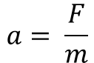
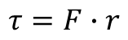
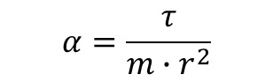
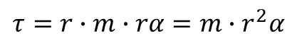
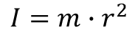
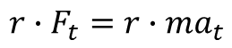



Torque
$$a= \frac{F}{m}$$
inertia
Angular acceleration
$$α= \frac{τ}{I}$$
$$τ=F∙r$$
$$F_{t}=ma_{t}$$
Moment of inertia
$${r∙F}_{t}=r∙ma_{t}$$
Rotational inertia
$$τ=r∙m∙rα=m∙r^{2}α$$
r
m
$$α_{tan}=r∙α$$
$$α=\frac{τ}{m∙r^{2}}$$
$$I=m∙r^{2}$$

Slide 47
Ref: CFB Boiler DSN-두산중

Slide 48
Requirements
Stable ash separation and recirculation
Minimum pressure drop for gas seal
Suction condition in cyclone
Stable response to particle load variation

Slide 49
Cyclone design criteria
Items | Sym | Unit | Value
Exit velocity of gas from combustor | vo | m/s | 15 - 20
Inlet velocity of gas to cyclone | vi | m/s | 20 - 25
Exit velocity of gas to vortex finder | ve | m/s | 30 - 35
Inlet velocity of gas to convection pass | Vc | m/s | 15 - 20
Gas velocity inside convection pass | Vi | m/s | < 12

Slide 50

Cyclone types

Slide 51
Wrap around cyclone
90
45

Slide 52
Traditional vs. High Efficiency
Traditional
High efficiency
Vi~20m/s
Vi~25m/s

Slide 53
Horizontal vs. down slide

Slide 54
Cone Angle
Β < 20deg avoild solid stay in con-mouth
β

Slide 55
Cyclone under
From Cyclone
Loop seal
Combustor
P_returnchamber
P_combustor
External Heart Exchanger

Slide 56
Loop seal
dc3
Particle flow
Combustor
dr
bh
oh
Length
Return Chamber
Length
Down Chamber
Width
P_combustor + P_return chamber = P_downchamber

Slide 57
External Heat Exchanger
dr2
dv
dr3
hb
he
width
depth
EHE

Slide 58
Return of EHE
Cyclone ash Split
Combustor
EHE
Aerataion
Fludizing air

Slide 59
Fluidized bed ash cooler
Air exit
Pressure
difference
Ash drain
Fluidizing air

Slide 60
Startup burner
Lance burner
Initial feeding condition specified by regulations

Slide 61
Ignition burner
Retractable lance burner
Necessary for hard carbon fuel
Anthracite, Petroleum coke…
2m

Slide 62

Duct burner
Requires air cooled distributor
Maximum temperature ~900℃
Heat ~ 20% of MCR
Water cooled distributor
1500℃Hot air
900℃
P/A

Slide 63

Primary Air Feed Duct and Start Up Burner
Primary air
900℃
Duct Burner
1500℃Hot air

Slide 64
Lance burner
Flame targeted on the top of bed surface.
Heating efficiency is low

Slide 65
Thermal expansion of Combustor

Slide 66
Thermal expansion of combustor
Expansion joint for
Bottom ash disposal facility
Connecting neck between Combustor to cyclone
Loop seal return to Combustor

Slide 67


Loop seal return
(X)
(O)

Slide 68
Return leg approach
> 45deg
elliptic
0.5m

Slide 69
Ash coller
High ash coal with high bottom ash flow
Not careful preatment (crushing) large particle that can’t pass through between cooling tubes
Most case smaller design

Slide 70
Caution
Water cooled barrel , air cooled, steel belt type
Water tube cooled ash cooler must have enough horizontal space between tubes
Careful Particle size control to prevent large bottom ash particle formation
Avoid clinker chunks fed into the water tube cooled ash cooler

Slide 71


Air-water Combined Bottom Ash Cooler
Hot air in
Figure; Harbin Boiler
Ash flow
Ash Cooler
Bottom ash
Tube rupture
Block on Ash drain

Slide 72

air-water combined bottom ash cooler
440t/h CFB Boiler, DFB

Slide 73

Rotary drum ash cooler
Bottom ash in
Air in
Shanghai Boiler 440TPH
Water
Bottom ash out

Slide 74

Rotary barrel type ash cooler
440t/h CFB Boiler, HBB

Slide 75

Rotary barrel ash cooler
Qinghuangdao power plant 300MWe CFBC

Slide 76


Air preheater
Vertical type
Horizontal type

Slide 77
Air preheater design
0.09
0.08
0.1
0.1
AIR
GAS

Slide 78
A/H Design specification
Shell and tube type
Vertical; tube - gas
Horizontal; tube - air
Flue gas velocity < 10m/s
Air velocity < 15m/s

Slide 79







Utilization of ash
Bottom ash
Fly ash
Clinker

Slide 80
Air heater for Large scale CFB
Rotary type air heater
Flue gas and air alternately pass honey comb.
Leak is the major problem

Slide 81

Rotary heat exchanger

Slide 82

Manhole and Soot blower
Soot Blower
Hot Cyclone
Center Pipe
FBC Boiler
Furnace
#1 S/B
#2 S/H
#2 S/B
#1 S/H
#3 S/B
Man hole
#4 S/B
Economizer.
#5 S/B
#6 S/B
Air Pre HTR

Slide 83
Air heater corrosion
Avoid wet corrosion
Apply tube coating to lowest unit

Slide 84

Low Temperature Corrosion
Hot corrosion
3rd S/H
2nd S/H
ECO
A/H
Wet Corrosion

Slide 85
Erosion Protection
Different measure for different location

Slide 86




CFBC Refraction Plan
Erosion resistant refractory
150mm
Erosion resistant refractory
150mm
Membrane water wall
Castable 150mm
Insulation 150mm
Mineral wool
Castable100mm

Slide 87
Erosion protection
Rear
Front
15deg
Exit height
Zone 4
Depth
Exit width
Zone 3
Width
Zone 2
Zone 1
17deg
Expansion zone
~1/2 Depth

Slide 88
Water wall protection

Slide 89

Refractory for CFB
http://www.agport.fi/english/materials.htm

Slide 90
연소로 종류별 위치별 내화재 (한국내화제품)

Slide 91
비정형케스타블(CRETO)

Slide 92
비정형 케스타블(MOLDIT)

Slide 93
정형(벽돌)케스타블(ML)

Slide 94
정형(벽돌)케스타블(HX)
BRAND NAME |  | HADEX
ITEMS |  | HX-35 | HX-35HD | HX-34 | HX-34HD | HX-34R | HX-32 | HX-32R | HX-ACR
Refractoriness(SK) |  | 35 | 35 | 34 | 34 | 34 | 32 | 32 | 33
Bulk Density |  | 2.25 | 2.3 | 2.2 | 2.25 | 2.2 | 2.1 | 2.1 | 2.3
Apparent |  | 16 | 14 | 16 | 14 | 16 | 16 | 16 | 15
Porosity(％)
Cold Crushing |  | 500 | 600 | 500 | 600 | 500 | 500 | 500 | 600
Strength(kg/㎠)
Refractoriness Under Load |  | 1480 | 1500 | 1450 | 1480 | 1420 | 1410 | 1380 | -
(2kg/㎠,T₂℃)
Permanent Linear |  | 0 | 0 | 1450℃ | 1450℃ | 1450℃ | 1350℃ | 1350℃ | 1350℃
Change(％) |  |  |  | X2hr | X2hr | X2hr | X2hr | X2hr | X2hr
(1500℃×2hr)
 |  |  |  | -0.2 | 0 | -0.2 | 0 | -0.2 | 0
Thermal Expansion(％) |  | 0.6 | 0.6 | 0.5 | 0.5 | 0.5 | 0.5 | 0.5 | 0.5
at 1000℃
Chemical Compo |  | 45 | 47 | 41 | 43 | 41 | 34 | 33 | 35
- sition | Al₂O₃ | 53 | 51 | 56 | 54 | 56 | 63 | 64 | 62
 | SiO₂
 | Fe₂O₃
Applications |  | *Glass | *Glass | *Glass | *Glass | *Boiler | *Lime | *Lime | *TiO₂
 |  | Melting | Melting | Melting | Melting | *Incinerator | Kiln | Kiln | Rotary
 |  | Tank | Tank | Tank | Tank | *Lime | *Various | *Various | Kiln
 |  | *Carbon | *Non | *Non | *Non | Rotary | Kiln & | Kiln &
 |  | Black | Ferrous | Ferrous | Ferrous | Kiln | Furnace | Furnace
 |  | Furnace | Metals | Metals | Metals |  | *Boiler | *Boiler
 |  | *Incinerator | Furnace | Furnace | Furnace
 |  | *Non | *Blast | *Incinerator | *Blast
 |  | Ferrous | Furnace | *Holding | Furnace
 |  | Metals |  | Furnace | *Lime
 |  | Furnace |  | *Checkers | Rotary
 |  | *Checkers |  |  | Kiln
 |  | *Others

Slide 95
조선내화제품
Combustor : 내마모용 TPC-HLCC
Air nozzle : 내마모용 INCT-120N
Hot Cyclone: 내마모; CJ-1, 단열벽돌 ; B-1
보드타입 단열재;HTD
Loopseal : 내마모; HSC-16H, 단열벽돌 ; B-1

Slide 96
Commercial CFBC monitoring and trouble shooting
Cyclone troubles
Superheater Erosion
Water wall
Erosion
Clinker
formation
Feeding problem with irregular fuel
Wet corrosion in low temp region
Start up
overheat

Slide 97
Draft System

Slide 98

Draft system
Fuel, sand, and ash bed material Raise to upper space
Particle exchanges heat with Furnace
Entrained particle (> 0.1mm) in Hot Gas collected in Cyclone, Returns to Furnace
Hot Gas Transfers heat to Super-heater, Economizer, while passes Convection Pass, Air heater, and Dust Collection hopper

Slide 99
Fan design
PA fan
SA fan
Loop seal air fan
EHE fan

Slide 100
Rear
Ignition burner
Ash drain
Combustor exit
Manhole
3
4
5
4
Left
3
3
5
4
F
F
Right
2
2
6
6
Fuel feeder/
Cyclone return
1
F
2
1
Sand feeding
At level 1
1
At level 2
At level 3
Front

Slide 101
Combustion air and fan selecton
 | Pressure [mmaq] | Temperature [C] | Rate [% stoichio.] | Ref.
Primary air | 2000 | 150~250 | 0.7~0.9 | Under stoichio.
Secondary air | 1000 | 25~250 | 0.3~0.5
Loop seal air | 3000~5000 | 25~250 | - | High P. air req.
Induced Fan | 650 | 150 | 1.2~1.4
Cooling air | 1000 | 25~ | -
Air leak | 0 | 25~ | 0 ~ 0.1 | Product dependent

Slide 102
Primary Air circuit
Fuel purge
Gas
Air heater
F
Flow M
air box
air distributor
Silencer
Damper
Aux feeder purge
A
B
C

Slide 103
Fuel feeding air
Cyclone
Ash
ID0.25
C
ID0.4
Combustor
Convection
pass
Bag filter
L
S
C
Cyclone
ID0.25
STK

Slide 104
Secondary air circuit
2nd air Level C
Gas
Air heater
Silencer
Damper
F
Flow M.
2nd air Level B
2nd air Level A
A
B
C

Slide 105
2nd air Loop
Cyclone
Ash
C
ID0.65
Combustor
Convection
pass
Bag filter
L
ID0.65
S
C
Cyclone
ID0.65
STK

Slide 106
Loop Seal Air circuit
F
Back pass
Filter
Stack
A
B
C

Slide 107
Ash cooler air circuit
F
Flow meter
air box
air distributor

Slide 108
Soot blower and Manhole
#3 S/B
#4 S/B
Man hole
#5 S/B
Man hole

Slide 109
Design Considerations
(For Solid Fuel Burning CFBC)
Fuel feeding system
Distributor – Bottom ash drain system
Temperature problems
Post combustion - Clinker control - Super heater tube corrosion
Fine particulates emission
Low heat transfer coefficient – low density

Slide 110
Feeder
Continuous feeding
No plugging
Handle ability
Control input heating value
Design items
Bucket elevator
Vibrating screen bypass line
Storage silo
Screw conveyer
Fuel feeding line

Slide 111

RDF feeder

Slide 112

Limestone feeder

Slide 113
Fuel feeding methods
A
B
SA
C
A
Loop seal feeding
B
Loop seal feeding
C
Direct feeding
PA

Slide 114



Fuel feeding system
Irregular shape fuel
Gas reverse flow
Plugging
Moisture variation

Slide 115
Fuel feeding
Loop seal
Sand,
limestone
Fuel
Fuel
K=0.5
45º
K=0.5
30º
900
30º
500
500
200
1750
2000
2000
1250
1360
1000

Slide 116

Typical Coal Feed
ULTRA-SUPERCRITICAL PRESSURE
CFB BOILER CONCEPTUAL DESIGN STUDY
Foster Wheeler North America Corp., 2006

Slide 117
Distributor
Low pressure drop
High dispersion
Caution not to erode neighboring nozzle
No dead zone
Easy drain of non-combustible

Slide 118
Distributor
2015 남동발전 여수화력 2호기

Slide 119


No gap allowed at the wall
P = P’
2011 군장에너지 3호기

Slide 120

Distributor resistance
$$∆P=K∙ρ∙\frac{v^{2}}{2∙g_{c}}$$
[kg/m2]
#3
#2
#3; K=1.5
#1
#2; K = 4xfx(L/D) = 4 x 0.0032 x (L/D)
#1; K=0.5 (C_{D} = 0.6)

Slide 121

Distributor-K chemical

Slide 122

Distributors-AE&E

Slide 123



Distributors-Metso

Slide 124

Water Cooled Air Distributor

Slide 125

Bed ash drain

Slide 126
Step distributor bed drain
Fuel
ID Fan
Bag house
d
Cyclone
Metal, gravel
Sand
Fluidizing gas
Drain ash and gravel mixture
FD Fan

Slide 127
Bed ash drain for coal
0.15
4.0
0.15
0.75
0.2
1.8
0.2
0.75
2.5
2.0
3.7

Slide 128

Air distributor
Ash drain hole
More flow holes in dark circle than White circle

Slide 129
Bed ash drain for RDF
K=0.5

Slide 130
Step Distributor

Slide 131
Δh1
ΔP1/ρ
Δh2
ΔP2/ρ
Δh3
ΔP3/ρ
Δh1+ΔP1/ρ=Δh2+ΔP2/ρ=Δh3+ΔP3/ρ

Slide 132




이물질

Slide 133




공기분배 및 하부회 배출 문제/ 해결 방안
PA Nozzle 전체모습 |  | PA Nozzle 변형, 막힘
* 대응방안: 계단형 경사 공기 Nozzle 및 하부회 배출 적용

Slide 134



분산판
Metso HYBEX BFBC

Slide 135
Post combustion
Incoming flue gas to S/H 2 < 750℃
No wing wall inside combustor to control combustor exit temperature and CO
Install post combustion chamber with water cooled wall
Location of cyclone move to front of combustor to secure space to install empty pass

Slide 136

Post combustion during solid fuel combustion
High cyclone outlet temperature due to post combustion

Slide 137

Flingeln Corrosion Diagram
SH3
SH2

Slide 138


Metal corrosion and protective coating
Electro-Chemical RXN
Sulfated or halogenated iron decomposition
Metal-halogenates
Metal-sulfides formation
Gas phase corrosion

Slide 139


CFBC Post combustion technology
Post combustion technology for light density SRF to Control delayed combustion in Convection Pass
Improve efficiency and lifetime of tubes
KIER
HYBEX

Slide 140

Anti corrosion technology

Slide 141

Solutions
Metal coating(Thermal spray)
Low steam temperature
T < 450C
Tube coating

Slide 142
Bed density control
Enhance cyclone efficiency?
Convection pass ash re-circulation
Enhance heat transfer coefficient

Slide 143
Effects of fly ash reburning on improving the CFB boiler combustion efficiency
Fly ash reburning is the main trend to improve the CFB boiler combustion efficiency
Enhancement of heat transfer coefficient

Slide 144
Fly ash recirculation
Cyclone efficiency decrease
DRUM
SH 2
SH 1
to STACK
HOT
CYCLONE
ECO
BAG FILTER
SDR
COMBUSTOR
A H
LOOPSEAL
Convection Pass Ash Return
SAF
Increased Fly ash Particle Size
SRF
AIR LINE
ASH REMOVAL
BURNER
PAF
144

Slide 145
Diagram of fly ash bottom feeding system

Slide 146
Non-mechanical dual loop seal
Cyclone efficiency decrease
DRUM
SH 2
SH 1
to STACK
HOT
CYCLONE
ECO
BAG FILTER
SDR
COMBUSTOR
A H
LOOPSEAL
SAF
EHE
BURNER
PAF
146

Slide 147


Non-mechanical dual loop seal
Feeder
Cyclone
Pressure
Measuring
Apparatus
Derivation pipe for
pressure balance
LC1
LC2
LC3
EHE
Riser
Compressed air
Butterfly
P7
P8
P9
valve
combustor
P4
P5
P6
h
EHE
P1
P2
P3
Q1
Q2
Q3
EHE
Riser
Air
supply
Schematic diagram of Batch apparatus(L) and CFB apparatus(R)

Slide 148
Results-Batch experiment
Relations between solid circulating flux(Gs) and the gas velocity.
(U₁/U_{mf}=3.19, 4.46, 7.96, 9.55, U₂/U_{mf}=1.91)

Slide 149
감사합니다.

